Slide 1
SQL Individual Assignment
PIZZA SALES SQL QUERIES
TAUFIK ISKANDAR

Slide 2
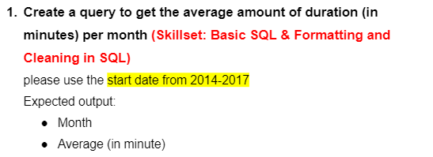
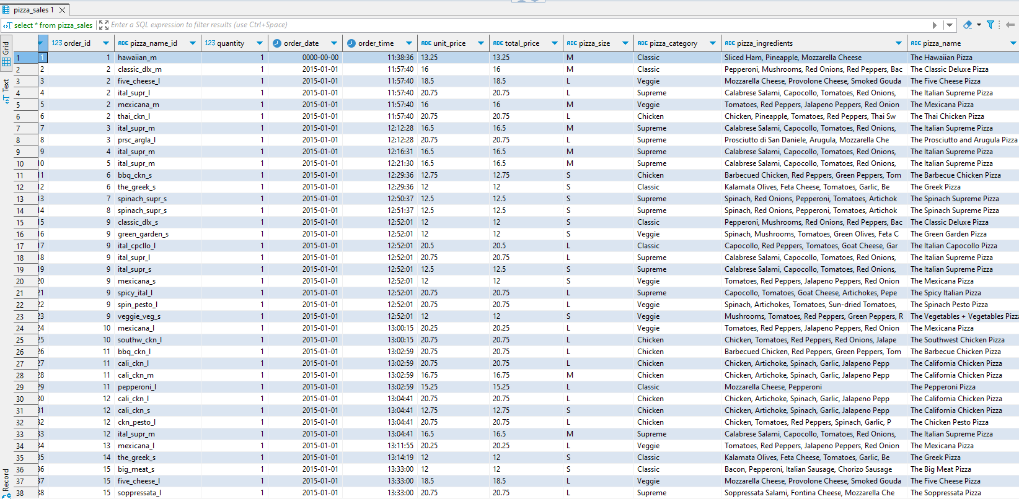
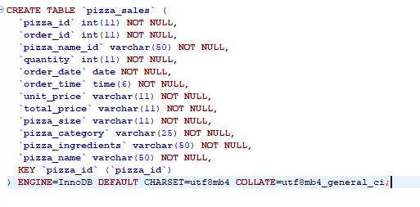
Question 1 Table Result Schema & Preview

Slide 3

1. Create Total Revenue:
syntax :
SELECT
SUM(TOTAL_PRICE) AS TOTAL_REVENUE
FROM
PIZZA_SALES;
RESULT:

Slide 4

2. Create Average Order Value:
SELECT
(SUM(TOTAL_PRICE) / COUNT(DISTINCT ORDER_ID)) AS AVG_ORDER_VALUE
FROM
PIZZA_SALES;
RESULT:

Slide 5

3. Create Total Pizzas Sold
SELECT
SUM(quantity) AS Total_pizza_sold
FROM
pizza_sales;
RESULT:

Slide 6

4. Create Total Orders
Syntax :
SELECT
COUNT(DISTINCT order_id) AS Total_Orders
FROM
pizza_sales;
RESULT:

Slide 7

5. Create Average Pizzas Per Order
SELECT
CAST(CAST(SUM(quantity) AS DECIMAL(10,2)) /
CAST(COUNT(DISTINCT order_id) AS DECIMAL(10,2)) AS DECIMAL(10,2))
AS Avg_Pizzas_per_order
FROM
pizza_sales;
RESULT:

Slide 8
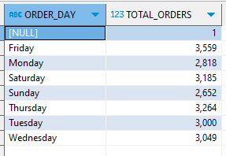
6. Create Daily Trend for Total Orders
SELECT
DAYNAME(ORDER_DATE) AS ORDER_DAY, COUNT(DISTINCT ORDER_ID) AS TOTAL_ORDERS
FROM
PIZZA_SALES
GROUP BY DAYNAME(ORDER_DATE);
RESULT:

Slide 9
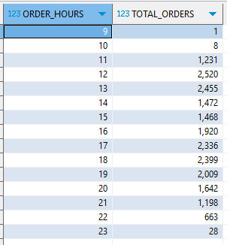
7. Create Hourly Trend for Orders
SELECT
HOUR(ORDER_TIME) AS ORDER_HOURS, COUNT(DISTINCT ORDER_ID) AS TOTAL_ORDERS
FROM
PIZZA_SALES
GROUP BY HOUR(ORDER_TIME)
ORDER BY HOUR(ORDER_TIME);
RESULT:

Slide 10
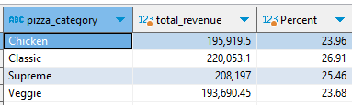
8. Create % of Sales by Pizza Category
SELECT
pizza_category, CAST(SUM(total_price) AS DECIMAL(10,2)) as total_revenue,
CAST(SUM(total_price) * 100 / (SELECT SUM(total_price) from pizza_sales) AS DECIMAL(10,2)) AS Percent
FROM
pizza_sales
GROUP BY pizza_category;
RESULT:

Slide 11
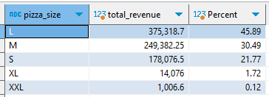
9. Create % Sales by Pizza Size
SELECT
pizza_size, CAST(SUM(total_price) AS DECIMAL(10,2)) as total_revenue,
CAST(SUM(total_price) * 100 / (SELECT SUM(total_price) from pizza_sales) AS DECIMAL(10,2)) AS Percent
FROM
pizza_sales
GROUP BY pizza_size
ORDER BY pizza_size;
RESULT:

Slide 12
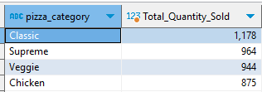
10. Create Total Pizza Sold by Pizza category
SELECT
pizza_category, SUM(quantity) as Total_Quantity_Sold
FROM
pizza_sales
WHERE
MONTH(order_date) = 2
GROUP BY pizza_category
ORDER BY Total_Quantity_Sold DESC;
RESULT:

Slide 13
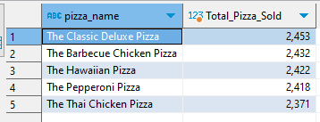
11. Create Top 5 Best Sellers by Total Pizzal Sold
SELECT
pizza_name, SUM(quantity) AS Total_Pizza_Sold
FROM
pizza_sales
GROUP BY pizza_name
ORDER BY Total_Pizza_Sold desc
LIMIT 5;
RESULT:

Slide 14
THANK YOU

